Slide 1
HTTP/2.0 Servlet 4.0

Slide 2
HOW WE GOT HERE
1991
HTTP 0.9
1999
HTTP 1.1
2015
HTTP 2.0
1996
HTTP 1.0
2009
SPDY 1.0

Slide 3

HTTP HISTORY
HTTP/2.0 based on SPDY ( developed by GOOGLE )
TESTS OF SPDY SHOWED :
in some cases, pages were loaded 55% faster
the average load time was reduced by 36%
SPDY
protocol

Slide 4
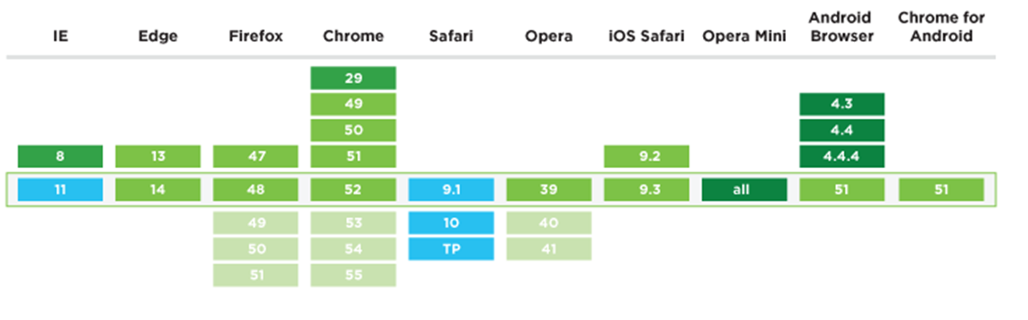
Browser Compatibility of HTTP/2

Slide 5
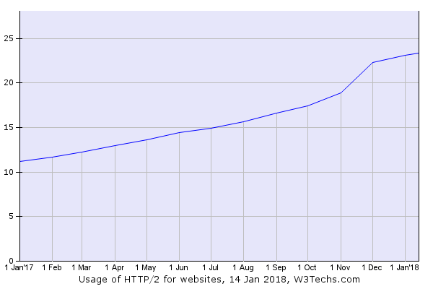
SUPPORT OF HTTP/2
22.3% of all Web sites support the HTTP/2 protocol

Slide 6

SUPPORT OF HTTP/2
IIS: Windows Server 2016
Apache 2.4.17
nginx 1.9.5
Apache Tomcat 9.0.0
WildFly 10
Jetty Stable-9
Netty 4.1
Payara 5.0
Vert.x
GlassFish 5.0

Slide 7
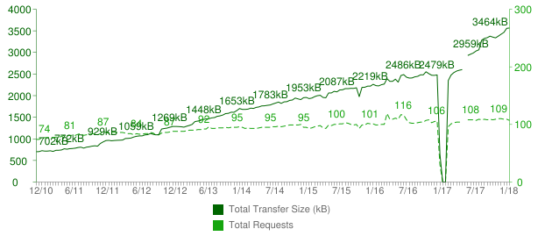
Total Transfer Size & Total Requests

Slide 8

Problem of HTTP/1.1
Responds in sequence
Head-of-Line blocking
One request per TCP connection
HTTP header fields are often repetitive and verbose

Slide 9
client
server
client
server
open
open
close
close

Slide 10


Slide 11
client
server
client
server
open
open
HOL
close
close

Slide 12
How developers resolves problems of HTTP 1.1
Creating sprites
Inlining
Joining
Sharing

Slide 13
How HTTP/2.0 resolves problems
Request/Response multiplexing
Stream Prioritization and Dependency
Server Push
Header compression

Slide 14
HTTP/2 Units
CONNECTION
FRAME
FRAME
FRAME
FRAME
STREAM
• Connection – single TCP connection
• Streams - channel that carries messages in two directions
• Messages - request or response
• Frames – messages, which are broken down for sending

Slide 15
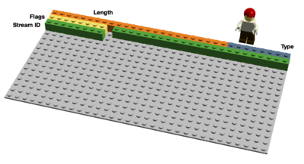
Binary Framing
LENGTH (24)
TYPE (8)
FLAGS (8)
R
STREAM IDENTIFIER (31)
FRAME PAYLOADS (0..N)

Slide 16
Type of Frames in HTTP/2.0
DATA
Used to transport HTTP message bodies
HEADERS
Used to communicate header fields for a stream
PRIORITY
Used to communicate sender-advised priority of a stream
RST_STREAM
Used to signal termination of a stream
SETTINGS
Used to communicate configuration parameters for the connection

Slide 17
Type of Frames in HTTP/2.0
PUSH_PROMISE
Used to signal a promise to serve the referenced resource
PING
Used to measure the roundtrip time and perform "liveness" checks
GOAWAY
Used to inform the peer to stop creating streams for current connection
WINDOW_UPDATE
Used to implement flow stream and connection flow control
CONTINUATION
Used to continue a sequence of header block fragments

Slide 18
HTTP/2.0 HEADLINE FEATURE
Multiplexing
Priority
Flow control
Header compression
Server push

Slide 19
HTTP/2.0 HEADLINE FEATURE
Multiplexing
Priority
Flow control
Header compression
Server push

Slide 20
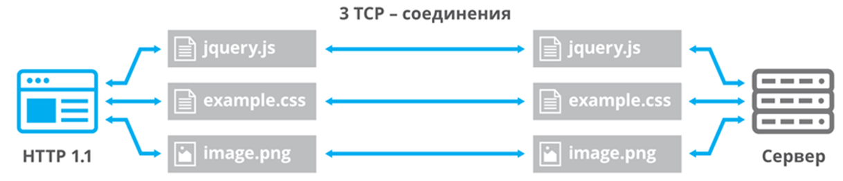
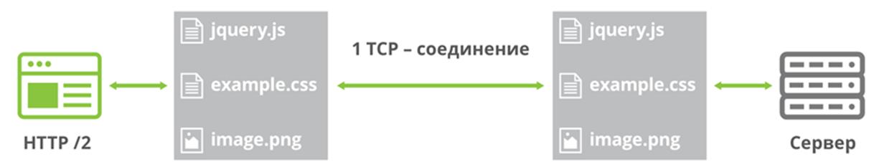
Request/Response Multiplexing

Slide 21
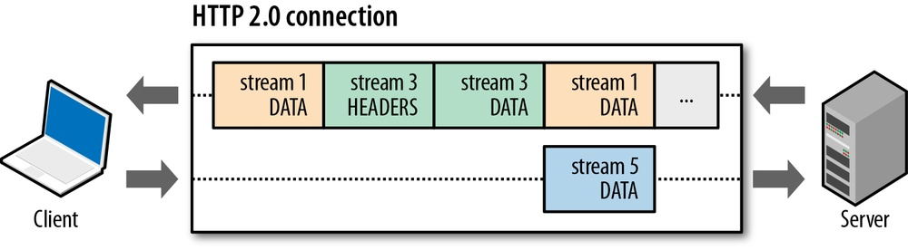
Request/Response Multiplexing

Slide 22
Maximum concurrent open TCP connections
Browser | Parallel connections per hostname
Chrome | 6
Firefox | 6
Opera | 6
Safari | 6
Internet Explorer 11 | 13
Microsoft Edge | 13

Slide 23
HTTP 1.1 round-trip
GET /install.html HTTP/1.1
GET /install HTTP/1.1
Host: maven.apache.org
SecurityToken: j13c72208c9u5fa2
Accept: application/json
Accept-Encoding: gzip
Content-Length: 327
Cache-Control: private, max-age=60, s-maxage=0
Vary: SecurityToken
Date: Wed, 17 Jan 2018 21:31:57 GMT
Content-Type: application/json
Content-Encoding: gzip
GZIPPED DATA

Slide 24
HTTP/2 round-trip
HEADERS
Stream: 3
Flags: END_HEADERS, END_STREAM
HEADERS
Stream: 3
Flags: END_HEADERS
:method: GET
:authority: maven.apache.org
:path: /install.html
securitytoken: j13c72208c9u5fa2
accept: application/json
accept-Encoding: gzip
:status: 200
content-Length: 327
cache-Control: private, max-age=60, s-maxage=0
vary: SecurityToken
date: Wed, 17 Jan 2018 21:31:57 GMT
content-Type: application/json
content-Encoding: gzip
DATA
Stream: 3
Flags: END_STREAM
GZIPPED DATA

Slide 25
Comparison requests of HTTP 1.1 & HTTP/2
Host: maven.apache.org
SecurityToken: j13c72208c9u5fa2
Accept: application/json
Accept-Encoding: gzip
HEADERS
Stream: 3
Flags: END_HEADERS, END_STREAM
GET /install.html HTTP/1.1
:method: GET
:authority: maven.apache.org
:path: /install.html
securitytoken: j13c72208c9u5fa2
accept: application/json
accept-Encoding: gzip

Slide 26
Comparison responses of HTTP 1.1 & HTTP/2
GET /install HTTP/1.1
HEADERS
Stream: 3
Flags: END_HEADERS
Content-Length: 327
Cache-Control: private, max-age=60, s-maxage=0
Vary: SecurityToken
Date: Wed, 17 Jan 2018 21:31:57 GMT
Content-Type: application/json
Content-Encoding: gzip
:status: 200
content-Length: 327
cache-Control: private, max-age=60, s-maxage=0
vary: SecurityToken
date: Wed, 17 Jan 2018 21:31:57 GMT
content-Type: application/json
content-Encoding: gzip
GZIPPED DATA
DATA
Stream: 3
Flags: END_STREAM
GZIPPED DATA

Slide 27
HTTP/2 interleaving
HEADERS
Stream: 3
Flags: END_HEADERS, END_STREAM
HEADERS
Stream: 5
Flags: END_HEADERS, END_STREAM
HEADERS
Stream: 3
Flags: END_HEADERS
HEADERS
Stream: 5
Flags: END_HEADERS
DATA
Stream: 5
Flags:
DATA
Stream: 3
Flags: END_STREAM
DATA
Stream: 5
Flags: END_STREAM

Slide 28
HTTP/2 canceling a Stream
HEADERS
Stream: 3
Flags: END_HEADERS, END_STREAM
HEADERS
Stream: 5
Flags: END_HEADERS, END_STREAM
HEADERS
Stream: 3
Flags: END_HEADERS
HEADERS
Stream: 5
Flags: END_HEADERS
RST_STREAM
Stream: 5
ErrorCode: CANCEL
DATA
Stream: 5
Flags:
DATA
Stream: 3
Flags: END_STREAM

Slide 29
HTTP/2 control frames
HEADERS
Stream: 3
Flags: END_HEADERS, END_STREAM
HEADERS
Stream: 5
Flags: END_HEADERS, END_STREAM
HEADERS
Stream: 3
Flags: END_HEADERS
HEADERS
Stream: 5
Flags: END_HEADERS
SETTINGS
Stream: 0
Flags:
DATA
Stream: 5
Flags:
SETTINGS
Stream: 0
Flags: ACK
DATA
Stream: 3
Flags: END_STREAM
DATA
Stream: 5
Flags: END_STREAM

Slide 30
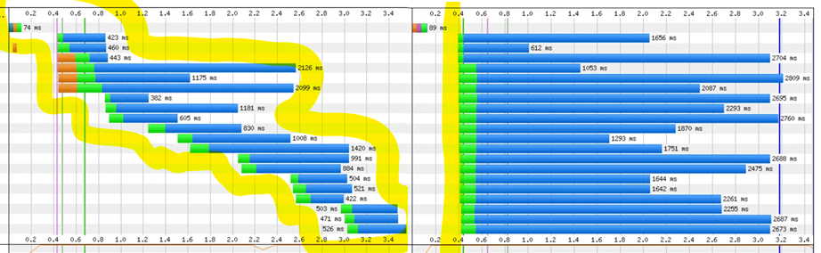

Slide 31
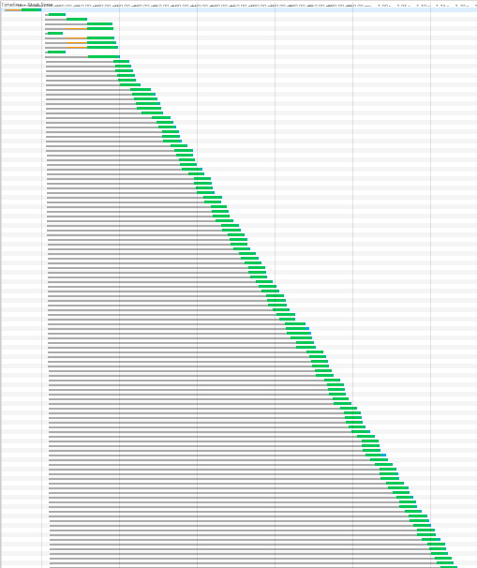
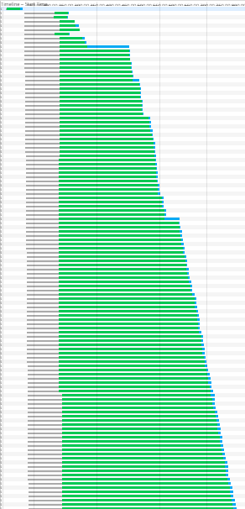

Slide 32
HTTP/2.0 HEADLINE FEATURE
Multiplexing
Priority
Flow control
Header compression
Server push

Slide 33
Stream Prioritization
Before any application data can be sent, a new stream must be created and the appropriate metadata such as HTTP headers must be sent.
In addition to the common header, an optional 31-bit stream priority has been added.
LENGTH (24)
TYPE (8)
FLAGS (8)
R
STREAM IDENTIFIER (31)
R
PRIORITY (31)
FRAME PAYLOADS (0..N)

Slide 34
HTTP/2 priority
HEADERS
Stream: 3
Flags: END_HEADERS, END_STREAM
HEADERS
Stream: 5
Flags: END_HEADERS, END_STREAM
Priority: 0
HEADERS
Stream: 3
Flags: END_HEADERS
HEADERS
Stream: 5
Flags: END_HEADERS
Priority: stream is more (lower number) or less (higher number) important
DATA
Stream: 5
Flags:
data might be sent earlier
DATA
Stream: 5
Flags: END_STREAM
DATA
Stream: 3
Flags: END_STREAM

Slide 35


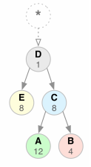
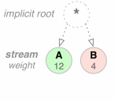
Stream Prioritization

Slide 36
Priority Stream
LENGTH (24)
TYPE (8)
FLAGS (8)
R
STREAM IDENTIFIER (31)
E
STREAM DEPENDENCY (31)
WEIGHT (8)

Slide 37
HTTP/2.0 HEADLINE FEATURE
Multiplexing
Priority
Flow control
Header compression
Server push

Slide 38
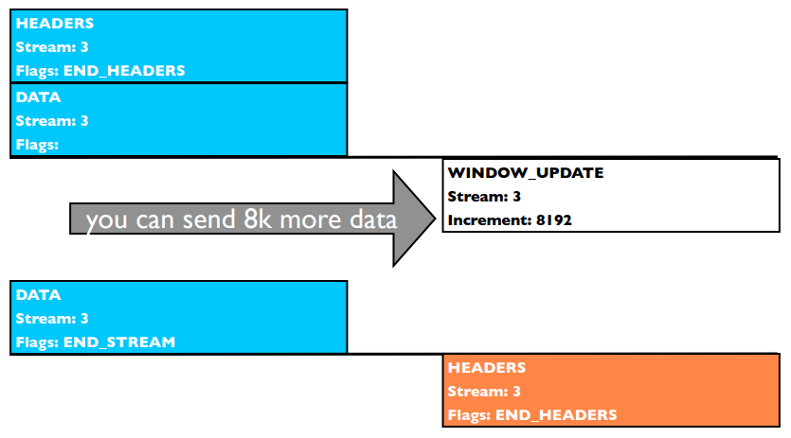
HTTP/2 flow control

Slide 39
HTTP/2.0 HEADLINE FEATURE
Multiplexing
Priority
Flow control
Header compression
Server push

Slide 40
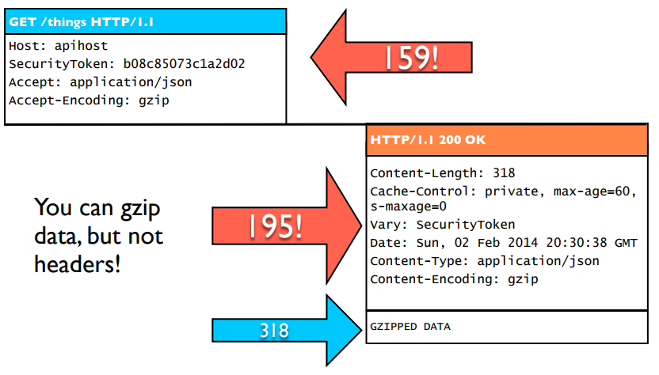
HTTP 1.1 headers

Slide 41
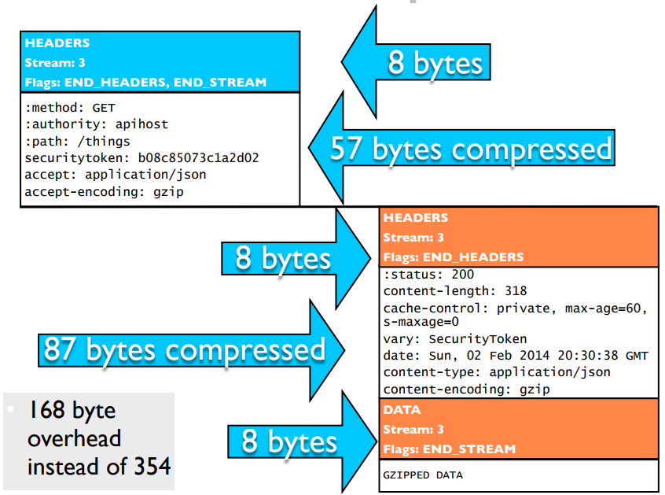
HTTP/2 header compression

Slide 42
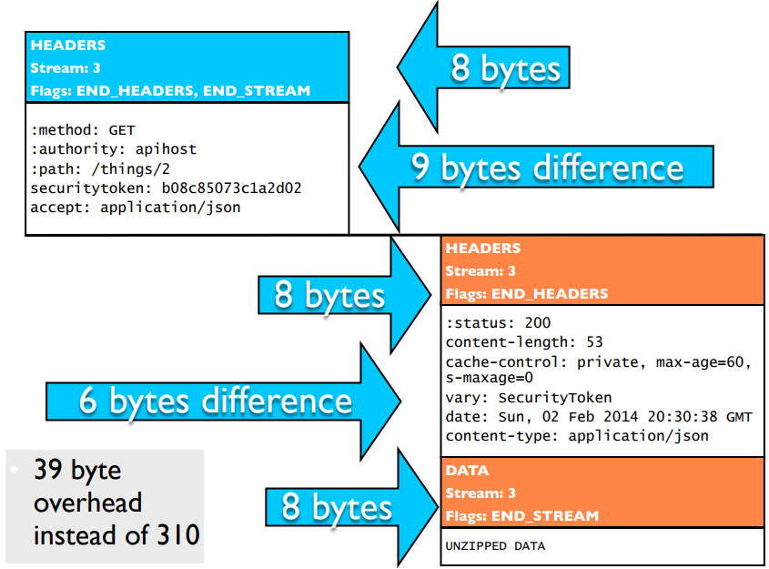
HTTP/2 reference tracking

Slide 43
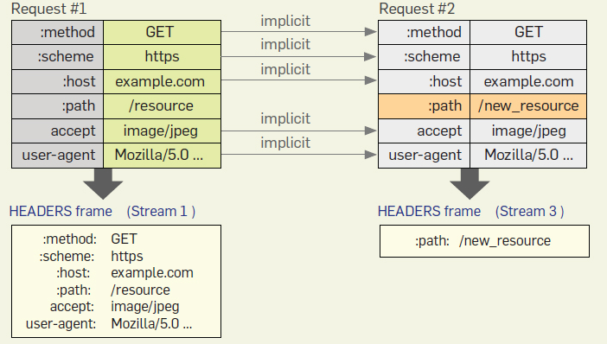
Header compression

Slide 44
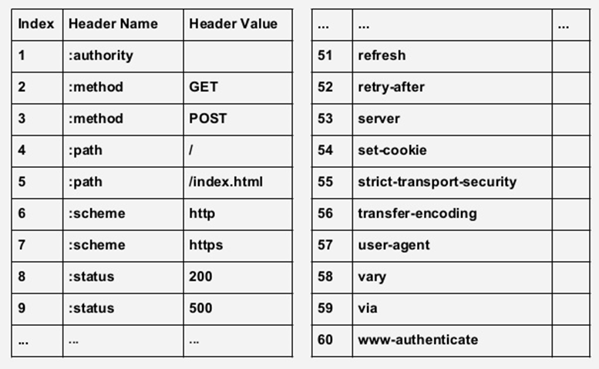
Static Header Table

Slide 45
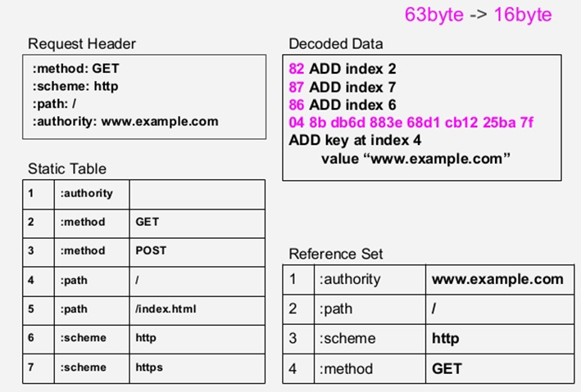
Header compression

Slide 46
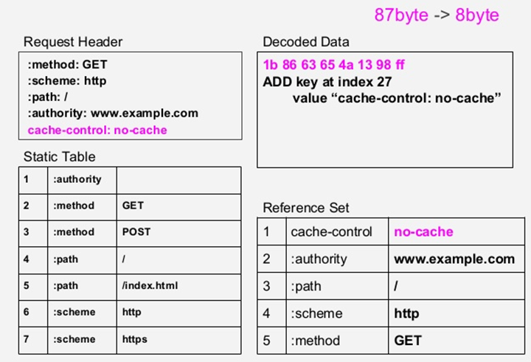
Header compression

Slide 47
HTTP/2.0 HEADLINE FEATURE
Multiplexing
Priority
Flow control
Header compression
Server push

Slide 48
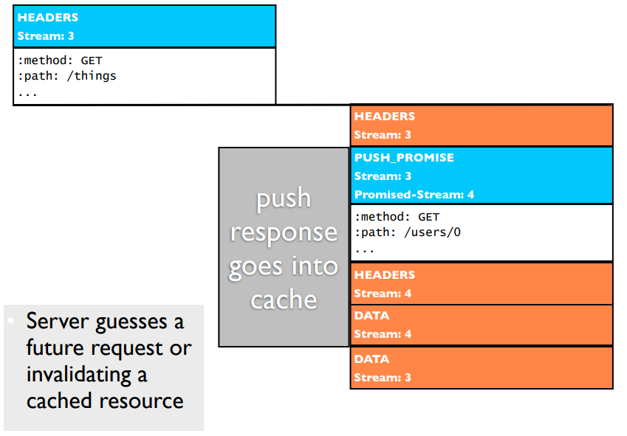
HTTP/2 push promise

Slide 49
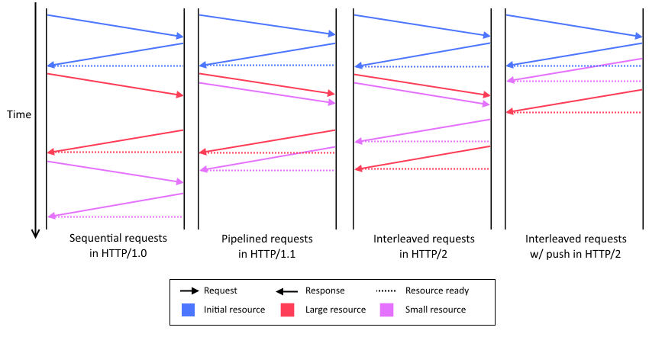
Comparison of time to fetch HTTP resources

Slide 50
Comparison of HTTP 1.1 and HTTP/2
HTTP/1.1 Page Load | HTTP/2 Page Load
Create six to eight connections. | Create a single connection
Request HTML page | Request HTML page
Receive HTML page | Receive HTML page
Decode HTML page | Decode HTML page
Request first six to eight files included in the HTML page, no priorities or dependencies. (Requests have uncompressed, plain-text headers.) | Request all files included in the HTML page, with priorities and dependencies. (Requests have compressed, binary headers.)
On each connection, wait for requested file to arrive | (Files returned, multiplexed on single connection, as ready.)
Request next file on now-open connection | -
Repeat 6-7 for each remaining file | -
Close six connections | Close single connection

Slide 51
When you don’t know if it supports HTTP/2
● “h2c” means no TLS connection
● “h2” means TLS connection [TLS-ALPN]
GET / HTTP/1.1
Host: server.example.com
Connection: Upgrade, HTTP2-Settings
Upgrade: h2c
HTTP2-Settings: <base64url encoding of HTTP/2 SETTINGS payload>
● A server MUST NOT upgrade the connection to HTTP/2 if this header field is not present or if more than one is present.
● A server MUST NOT send this header field.
[ Response ]
HTTP/1.1 101 Switching Protocols
Connection: Upgrade
Upgrade: h2c
Implicit acknowledgement of HTTP2-Settings

Slide 52
 | 41 req 172 kb | 66 req 215 kb | 130 req 427 kb | 230 req 2.0 mb | 330 req 4.2 mb | 430 req 5.4 mb
HTTP/2 | 332.37 | 415.33 | 774.13 | 1.26 | 1.83 | 2.31
HTTP 1.1 | 545.67 | 629.30 | 877.77 | 1.40 | 1.94 | 2.46
% | 64.18 | 51.52 | 13.39 | 11.61 | 5.73 | 6.52

Slide 53
Configure Tomcat 9 for HTTP/2
Open the conf/server.xml file and make the following configuration changes.
<Connector port="8443" protocol="org.apache.coyote.http11.Http11NioProtocol"
maxThreads="150" SSLEnabled="true" scheme="https" secure="true"
sslImplementationName="org.apache.tomcat.util.net.jsse.JSSEImplementation"
keystoreFile=“/conf/tomcat-sslkey" keystorePass=“*******"
clientAuth="false" sslProtocol="TLS">
<UpgradeProtocol className="org.apache.coyote.http2.Http2Protocol“
initialWindowSize=“65535”
keepAliveTimeout=“-1”
maxConcurrentStreams=“200”
/>
</Connector>

Slide 54
Servlet 4.0 dependency
<dependency>
<groupId>javax.servlet</groupId>
<artifactId>javax.servlet-api</artifactId>
<version>4.0.0</version>
<scope>provided</scope>
</dependency>

Slide 55
Servlet 4.0 brings HTTP/2 to Java EE
The Servlet API is well positioned to enable HTTP/2 optimization and to allow frameworks to leverage server push.
Expose key features to the API:
Server Push
Stream Prioritization
Request/Response multiplexing
Upgrade from HTTP 1.1

Slide 56
Servlet 4.0 New Features
Add a new class Priority:
exclusive ( ) : Boolean
streamId ( ): Int
weight ( ): Int
Add methods to HttpServletRequest:
getPriority ( ): Priority
getStreamId ( ): Int
Add methods to HttpServletResponse:
getPriority ( ): Priority
setPriority (Priority p): Unit
getStreamId ( ): Int

Slide 57
Servlet 4.0 New Features
Add method to ServletContext:
setRequestCharacterEncoding ( )
setResponseCharacterEncoding ( )
setSessionTimeout (minutes: Int)
addJspFile (name: String, jspFile:String)
Add new XML elements in web.xml:
<request-character-encoding />
<response-character-encoding />
<default-context-path />
Add new classes GenericFilter, HttpFilter

Slide 58
Typical Journey
browser
servlet
GET /index.html
PushBuilder
request.newPushBuilder( )
setPath(“/style.css”)
push( )
setPath(“/jquery.js”)
push( )
style.css
jquery.js
index.html

Slide 59
Push Builder from HTTP Request
fun getHttpSample(req: HttpServletRequest, resp: HttpServletResponse): String { req.newPushBuilder()?.path("/res/css/style.css")?.push() req.newPushBuilder()?.path("/res/images/logo.png")?.push() req.newPushBuilder()?.path("/res/images/background.jpg")?.push()
PushBuilder
addHeader(String, String): PushBuilder
etag(String): PushBuilder
lastModified(String): PushBuilder
queryString(String): PushBuilder
sessionId(String): PushBuilder
path(String): PushBuilder
push( )
…( )
I
HttpServletRequest
getPushBuilder( ): PushBuilder
…( )
I

Slide 60
Push Builder from HTTP Request
fun push1(req: HttpServletRequest, resp: HttpServletResponse) { val pushBuilder = req.newPushBuilder() pushBuilder?.apply { for (i in 1..250) { pushBuilder .path("res/images/space/space_$i.jpg") .addHeader("content-type", "image/jpg") .push() } }

Slide 61
Filter and Server Push feature
@WebFilter(urlPatterns = ["/*"])
class PushFilter : Filter {
override fun doFilter(req: ServletRequest, resp: ServletResponse, chain: FilterChain) {
val httpRequest: HttpServletRequest = req as HttpServletRequest
val requestURI = httpRequest.requestURI
val pushBuilder = httpRequest?.newPushBuilder()
when (requestURI) {
"index.html" -> {
pushBuilder?.path("/style.css")?.push()
pushBuilder?.path("/logo.png")?.push()
}
else -> pushBuilder?.path("/nature.png")?.push()
}
chain.doFilter(req, resp)
}
}

Slide 62
What about HTTP/2 client?
Client for HTTP/2 has been introduced in Java 9:
jdk.incubator.httpclient

Slide 63
Creating HTTP/2 client
val client: HttpClient = HttpClient.newHttpClient()
val client: HttpClient = HttpClient.newBuilder() .version(HttpClient.Version.HTTP_2) .build()

Slide 64
HTTP/2 client – GET request
val request: HttpRequest = HttpRequest.newBuilder() .uri(URI("http:/google.com.ua")) .GET() .build()
val response: HttpResponse<String> = client.send(
request, HttpResponse.BodyHandler.asString())

Slide 65
Conclusion: what we get with HTTP/2
• 1 socket for 100+ concurrent streams.
• Advanced features like:
flow control
cancellation
cache push.
• Dramatically less header overhead.

Slide 66
THANK YOU!

